Slide 1

Exercises for Chapter 3:
Networking and Internetworking
From Coulouris, Dollimore, Kindberg and Blair
Distributed Systems:
Concepts and Design
Edition 5, © Addison-Wesley 2012

Slide 2
Exercise 3.1
A client sends a 200 byte request message to a service, which produces a response containing 5000 bytes. Estimate the total time to complete the request in each of the following cases, with the performance assumptions listed below:
i) Using connectionless (datagram) communication (for example, UDP);
ii) Using connection-oriented communication (for example, TCP);
iii) The server process is in the same machine as the client.
[Latency per packet
(local or remote, incurred on both send and receive): 5 ms
Connection setup time (TCP only): 5 ms
Data transfer rate: 10 Mbps
MTU: 1000 bytes
Server request processing time: 2 ms
Assume that the network is lightly loaded.]
pages 82, 122
Instructor’s Guide for Coulouris, Dollimore, Kindberg and Blair, Distributed Systems: Concepts and Design Edn. 5
© Pearson Education 2012
Notes:
Send and re eive latencies include (OS) software overheads and network delays
UDP: 5 + 2000/10000 + 2 + 5(5 + 10000/10000) = 37.2 ms
TCP: 5 + 5 + 2000/10000 + 2 + 5(5 + 10000/10000) = 42.2 ms
Same machine: the message can be sent by a single in memory copy; estimate inter-process data transfer rate 40 Mbps. Latency/message is about 5 millisecond. Time for server call: 5 + 2000/40000 + 5 + 50000/40000 = 11.3 ms
---------------
The send and receive latencies include (operating system) software overheads as well as network delays.
Assuming that the former dominate, then the estimates are as below. If network overheads dominate,
then the times may be reduced because the multiple response packets can be transmitted and received
right after each other.
i) UDP: 5 + 2000/10000 + 2 + 5(5 + 10000/10000) = 37.2 milliseconds
ii) TCP: 5 + 5 + 2000/10000 + 2 + 5(5 + 10000/10000) = 42.2 milliseconds
iii)same machine: the messages can be sent by a single in memory copy; estimate interprocess data transfer
rate at 40 megabits/second. Latency/message ~5 milliseconds. Time for server call:
5 + 2000/40000 + 5 + 50000/40000 = 11.3 milliseconds

Slide 3
Exercise 3.2
The Internet is far too large for any router to hold routing information for all destinations. How does the Internet routing scheme deal with this issue?
pages 98, 114
Instructor’s Guide for Coulouris, Dollimore, Kindberg and Blair, Distributed Systems: Concepts and Design Edn. 5
© Pearson Education 2012
Notes:
If a router does not find the network id portion of a destination address in its routing table, it dispatches the packet to a default address, an adjacent gateway or router that is designated as responsible for routing the packets for which there is no routing information available.
Each router’s default address carries such packets towards a router that has more complete routing information, until one is encountered that has a specific entry for the relevant network id.

Slide 4
Exercise 3.3
What is the task of an Ethernet switch? What tables does it maintain?
pages 105, 130
Instructor’s Guide for Coulouris, Dollimore, Kindberg and Blair, Distributed Systems: Concepts and Design Edn. 5
© Pearson Education 2012
Notes:
Routing tables giving the Ethernet addresses and network id for all hosts on the local network
It does this by “learning” …
If the detonation is not found …
If the destination is on the same Ethernet as the source …
In all other cases …

Slide 5
Exercise 3.4
Make a table similar to Figure 3.5 describing the work done by the software in each protocol layer when Internet applications and the TCP/IP suite are implemented over an Ethernet.
pages 94, 122, 130
Instructor’s Guide for Coulouris, Dollimore, Kindberg and Blair, Distributed Systems: Concepts and Design Edn. 5
© Pearson Education 2012
Notes:
See next page
-----------------
Layer Description Examples
Application Protocols that are designed to meet the communication requirements of
specific applications, often defining the interface to a service. network
representation that is independent of the representations used in individual
computers. Encryption is performed in this layer.
HTTP, FTP,
SMTP,
CORBA IIOP,
Secure Sockets
Layer, CORBA
Data Rep
Transport UDP: checksum validation, delivery to process ports. TCP: segmentation, flow
control, acknowledgement and reliable delivery.
TCP, UDP
Network IP addresses translated to Ethernet addresses (using ARP). IP packets
segmented into Ether packets.
IP
Data link Ethernet CSMA CD mechanism. Ethernet MAC
Layer
Physical Various Ethernet transmission standards. Ethernet baseband
signalling

Slide 6
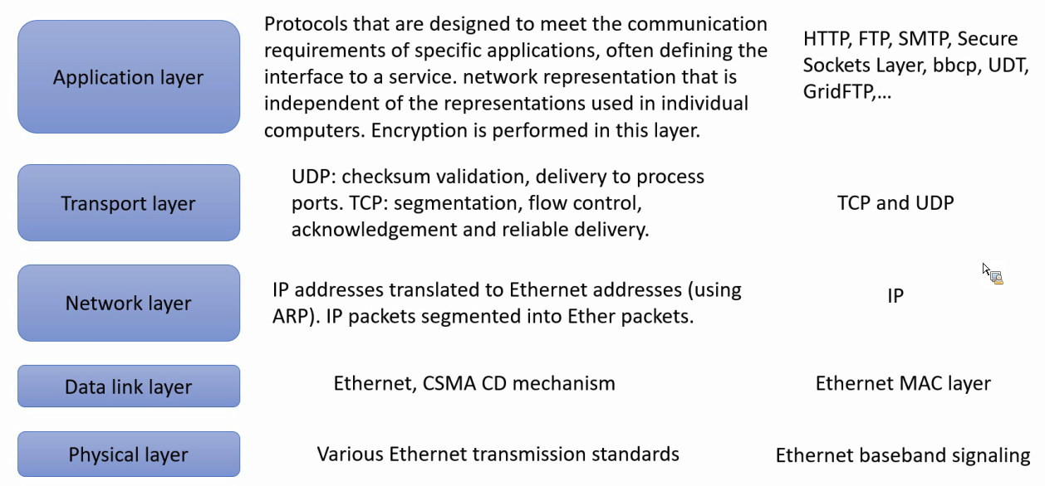
Exercise 3.4
Make a table similar to Figure 3.5 describing the work done by the software in each protocol layer when Internet applications and the TCP/IP suite are implemented over an Ethernet.
pages 94, 122, 130
Instructor’s Guide for Coulouris, Dollimore, Kindberg and Blair, Distributed Systems: Concepts and Design Edn. 5
© Pearson Education 2012
Notes:
See picture
-----------------
Layer Description Examples
Application Protocols that are designed to meet the communication requirements of
specific applications, often defining the interface to a service. network
representation that is independent of the representations used in individual
computers. Encryption is performed in this layer.
HTTP, FTP,
SMTP,
CORBA IIOP,
Secure Sockets
Layer, CORBA
Data Rep
Transport UDP: checksum validation, delivery to process ports. TCP: segmentation, flow
control, acknowledgement and reliable delivery.
TCP, UDP
Network IP addresses translated to Ethernet addresses (using ARP). IP packets
segmented into Ether packets.
IP
Data link Ethernet CSMA CD mechanism. Ethernet MAC
Layer
Physical Various Ethernet transmission standards. Ethernet baseband
signalling

Slide 7
Exercise 3.5
How has the end-to-end argument [Saltzer et al. 1984] been applied to the design of the Internet? Consider how the use of a virtual circuit network protocol in place of IP would impact the feasibility of the World Wide Web.
pages 61, 96, 106, [www.reed.com]
Instructor’s Guide for Coulouris, Dollimore, Kindberg and Blair, Distributed Systems: Concepts and Design Edn. 5
© Pearson Education 2012
Notes:
See the paper posted on moodle

Slide 8
Exercise 3.6
Can we be sure that no two computers in the Internet have the same IP addresses?
page 108
Instructor’s Guide for Coulouris, Dollimore, Kindberg and Blair, Distributed Systems: Concepts and Design Edn. 5
© Pearson Education 2012
Notes:
This depends on the allocation of network ids to user organizations by the Network Information Center
Networks with unauthorized network ids may become connected, in which case the requirement for unique ID address is broken

Slide 9
Exercise 3.7
Compare connectionless (UDP) and connection-oriented (TCP) communication for the implementation of each of the following application-level or presentation-level protocols:
i) virtual terminal access (for example, Telnet);
ii) file transfer (for example, FTP);
iii) user location (for example, rwho, finger);
iv) information browsing (for example, HTTP);
v) remote procedure call.
page 122
Instructor’s Guide for Coulouris, Dollimore, Kindberg and Blair, Distributed Systems: Concepts and Design Edn. 5
© Pearson Education 2012
Notes:
Long duration of sessions. TCP
Transmission of large volumes of data. TCP
Messages are short. UDP
The volume of data could be large or small. both
RPC achieves reliability by means of timeouts and re-trys. UDP
--------------
i) The long duration of sessions, the need for reliability and the unstructured sequences of characters
transmitted make connection-oriented communication most suitable for this application. Performance is
not critical in this application, so the overheads are of little consequence.
ii) File calls for the transmission of large volumes of data. Connectionless would be ok if error rates are low
and the messages can be large, but in the Internet, these requirements aren’t met, so TCP is used.
iii)Connectionless is preferable, since messages are short, and a single message is sufficient for each
transaction.
iv)Either mode could be used. The volume of data transferred on each transaction can be quite large, so
TCP is used in practice.
v) RPC achieves reliability by means of timeouts and re-trys. so connectionless (UDP) communication is
often preferred.

Slide 10
Exercise 3.8
Explain how it is possible for a sequence of packets transmitted through a wide area network to arrive at their destination in an order that differs from that in which they were sent. Why can’t this happen in a local network? Can it happen in an ATM network?
pages 97, 131
Instructor’s Guide for Coulouris, Dollimore, Kindberg and Blair, Distributed Systems: Concepts and Design Edn. 5
© Pearson Education 2012
Notes:
Routing is determined dynamically for each packet
TCP
Adding sequence numbers to the packets and re-ordering them at the receiving host
LAN
It can’t happen because the medium provides only a single channel connecting all of the hosts on the network
Packets are therefore transmitted and received in strict sequence

Slide 11
Exercise 3.9
A specific problem that must be solved in remote terminal access protocols such as Telnet is the need to transmit exceptional events such as ‘kill signals’ from the ‘terminal’ to the host in advance of previously-transmitted data. Kill signals should reach their destination ahead of any other ongoing transmissions. Discuss the solution of this problem with connection-oriented and connectionless protocols.
page 122
Instructor’s Guide for Coulouris, Dollimore, Kindberg and Blair, Distributed Systems: Concepts and Design Edn. 5
© Pearson Education 2012
Notes:
Example: the kill signal
Should reach the receiving process quickly even when there is buffer overflow or other exceptional conditions at receiving host
Out-of-band signaling
Connection-oriented case
Connectionless case
-------------
The problem is that a kill signal should reach the receiving process quickly even when there is buffer overflow
(e.g. caused by an infinite loop in the sender) or other exceptional conditions at the receiving host.
With a connection-oriented, reliable protocol such as TCP, all packets must be received and
acknowledged by the sender, in the order in which they are transmitted. Thus a kill signal cannot overtake other
data already in the stream. To overcome this, an out-of-band signalling mechanism must be provided. In TCP
this is called the URGENT mechanism. Packets containing data that is flagged as URGENT bypass the flowcontrol
mechanisms at the receiver and are read immediately.
With connectionless protocols, the process at the sender simply recognizes the event and sends a
message containing a kill signal in the next outgoing packet. The message must be resent until the receiving
process acknowledges it.

Slide 12
Exercise 3.10
What are the disadvantages of using network-level broadcasting to locate resources:
i) in a single Ethernet?
ii) in an intranet?
To what extent is Ethernet multicast an improvement on broadcasting?
page 130
Instructor’s Guide for Coulouris, Dollimore, Kindberg and Blair, Distributed Systems: Concepts and Design Edn. 5
© Pearson Education 2012
Notes:
Ethernet broadcasting does not happen very often
Just once for each host to locate other hosts on the local net that it needs to communicate with
It is hardly feasible in a large-scale network such as the Internet
Ethernet multicast address are matched in the Ethernet controller and are passed up to the OS only for addresses that match multicast groups the local host is subscribing to

Slide 13
Exercise 3.11
Suggest a scheme that improves on MobileIP for providing access to a web server on a mobile device which is sometimes connected to the Internet by mobile phone and at other times has a wired connection to the Internet at one of several locations.
page 120
Instructor’s Guide for Coulouris, Dollimore, Kindberg and Blair, Distributed Systems: Concepts and Design Edn. 5
© Pearson Education 2012
Notes:
The idea is to exploit the cellular phone system to locate the mobile device and to give the IP address of its current location to the client.

Slide 14
Exercise 3.12
Show the sequence of changes to the routing tables in Figure 3.8 that would occur (according to the RIP algorithm given in Figure 3.9) after the link labelled 3 in Figure 3.7 is broken.
pages 98–101
Instructor’s Guide for Coulouris, Dollimore, Kindberg and Blair, Distributed Systems: Concepts and Design Edn. 5
© Pearson Education 2012
Notes:
See next page
-------
See following 4 pages

Slide 15
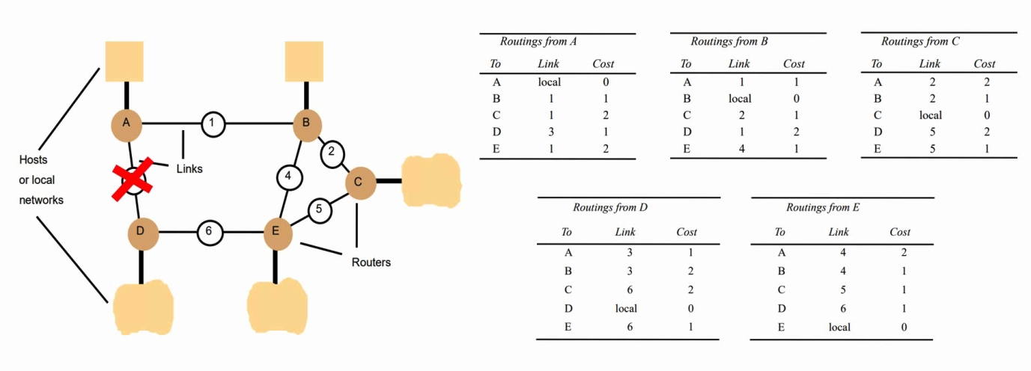
Exercise 3.12
Show the sequence of changes to the routing tables in Figure 3.8 that would occur (according to the RIP algorithm given in Figure 3.9) after the link labelled 3 in Figure 3.7 is broken.
pages 98–101
Instructor’s Guide for Coulouris, Dollimore, Kindberg and Blair, Distributed Systems: Concepts and Design Edn. 5
© Pearson Education 2012
Notes:
Problem is here, the steps are the same as the solution.
-------
See following 4 pages

Slide 16
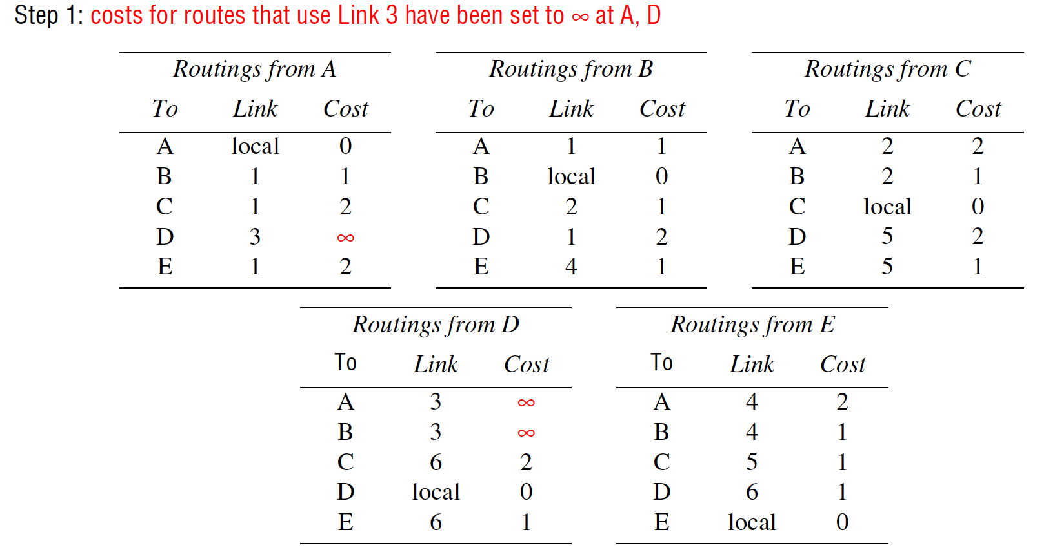
Exercise 3.13
Instructor’s Guide for Coulouris, Dollimore, Kindberg and Blair, Distributed Systems: Concepts and Design Edn. 5
© Pearson Education 2012
Notes:
-----
Routing tables with changes shown in red (grey in monochrome printouts):
Step 1: costs for routes that use Link 3 have been set to ∞ at A, D
Step 2: after first exchange of routing tables
Step 3: after second exchange of routing tables
Step 4: after third exchange of routing tables.

Slide 17
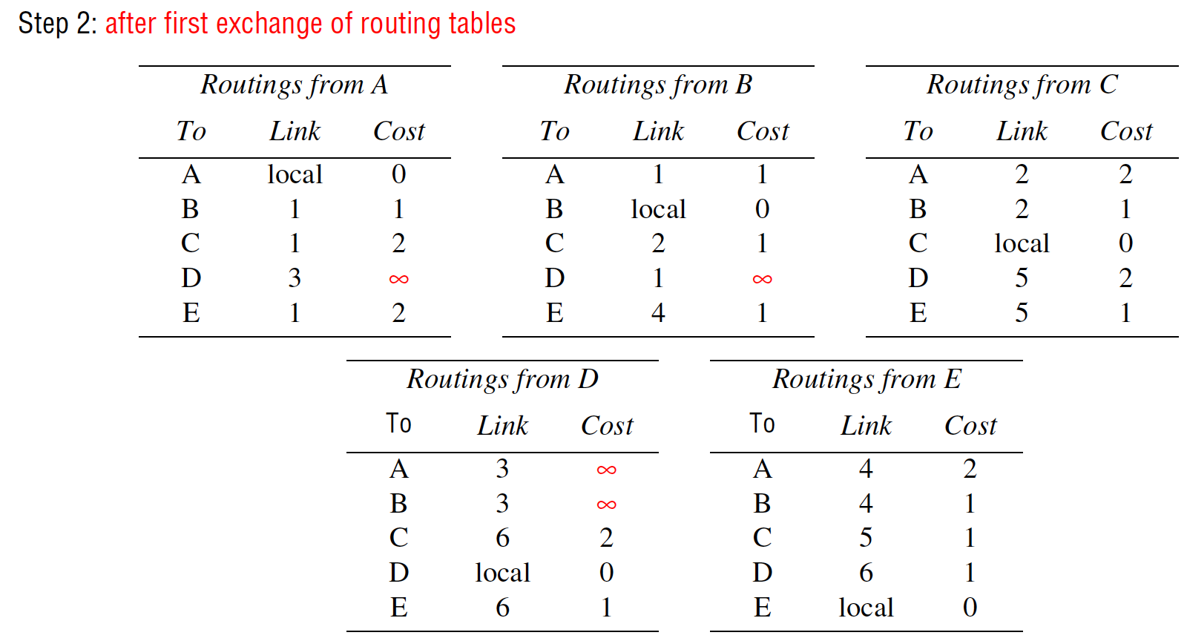
Exercise 3.13
Instructor’s Guide for Coulouris, Dollimore, Kindberg and Blair, Distributed Systems: Concepts and Design Edn. 5
© Pearson Education 2012
Notes:
-----
Routing tables with changes shown in red (grey in monochrome printouts):
Step 1: costs for routes that use Link 3 have been set to ∞ at A, D
Step 2: after first exchange of routing tables
Step 3: after second exchange of routing tables
Step 4: after third exchange of routing tables.

Slide 18
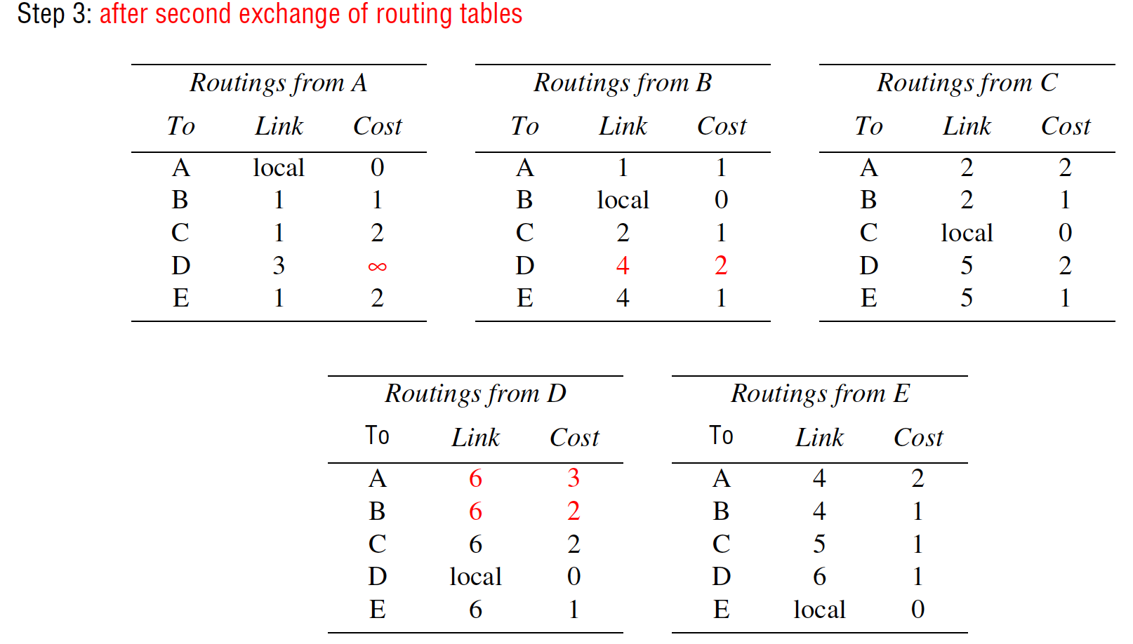
Exercise 3.13
Instructor’s Guide for Coulouris, Dollimore, Kindberg and Blair, Distributed Systems: Concepts and Design Edn. 5
© Pearson Education 2012
Notes:
-----
Routing tables with changes shown in red (grey in monochrome printouts):
Step 1: costs for routes that use Link 3 have been set to ∞ at A, D
Step 2: after first exchange of routing tables
Step 3: after second exchange of routing tables
Step 4: after third exchange of routing tables.

Slide 19
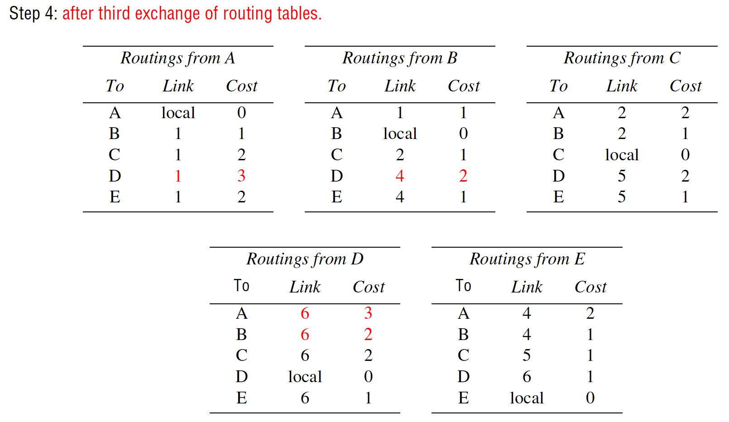
Exercise 3.13
Instructor’s Guide for Coulouris, Dollimore, Kindberg and Blair, Distributed Systems: Concepts and Design Edn. 5
© Pearson Education 2012
Notes:
-----
Routing tables with changes shown in red (grey in monochrome printouts):
Step 1: costs for routes that use Link 3 have been set to ∞ at A, D
Step 2: after first exchange of routing tables
Step 3: after second exchange of routing tables
Step 4: after third exchange of routing tables.

Slide 20
Exercise 3.13
Use the diagram in Figure 3.13 as a basis for an illustration showing the segmentation and encapsulation of an HTTP request to a server and the resulting reply. Assume that the request is a short HTTP message, but the reply includes at least 2000 bytes of HTML.
pages 93, 107
Instructor’s Guide for Coulouris, Dollimore, Kindberg and Blair, Distributed Systems: Concepts and Design Edn. 5
© Pearson Education 2012
Notes:
See next page.
Application message
TCP header
Ethernet header
Ethernet frame
port
TCP
IP
IP header
------
Left to the reader.

Slide 21
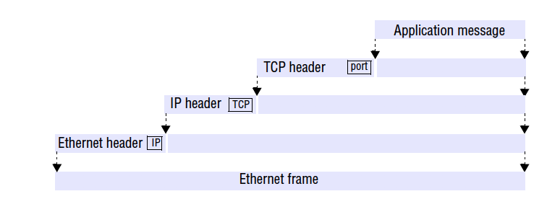
Exercise 3.13
Use the diagram in Figure 3.13 as a basis for an illustration showing the segmentation and encapsulation of an HTTP request to a server and the resulting reply. Assume that the request is a short HTTP message, but the reply includes at least 2000 bytes of HTML.
pages 93, 107
Instructor’s Guide for Coulouris, Dollimore, Kindberg and Blair, Distributed Systems: Concepts and Design Edn. 5
© Pearson Education 2012
Notes:
Application message
TCP header
Ethernet header
Ethernet frame
port
TCP
IP
IP header
------
Left to the reader.

Slide 22
Exercise 3.14
Consider the use of TCP in a Telnet remote terminal client. How should the keyboard input be buffered at the client? Investigate Nagle’s and Clark’s algorithms [Nagle 1984, Clark 1982] for flow control and compare them with the simple algorithm described on page 124 when TCP is used by
(a) a web server,
(b) a Telnet application,
(c) a remote graphical application with continuous mouse input.
pages 102, 124
Instructor’s Guide for Coulouris, Dollimore, Kindberg and Blair, Distributed Systems: Concepts and Design Edn. 5
© Pearson Education 2012
Notes:
Basic TCP buffer algorithm is not very efficient for interactive input
Nagle’s algorithm is designed for this:
Requires the sending machine to send any bytes found in the output buffer, then wait for an acknowledgement. Whenever an ACK is received, any additional characters in the buffer are sent
For a web server: …
For a remote shell: …
For a continuous mouse input: …
-------
The basic TCP buffering algorithm described on p. 105 is not very efficient for interactive input. Nagle’s
algorithm is designed to address this. It requires the sending machine to send any bytes found in the output
buffer, then wait for an acknowledgement. Whenever an acknowledgement is received, any additional
characters in the buffer are sent. The effects of this are:
a) For a web server: the server will normally write a whole page of HTML into the buffer in a single write.
When the write is completed, Nagle’s algorithm will send the data immediately, whereas the basic
algorithm would wait 0.5 seconds. While the Nagle’s algorithm is waiting for an acknowledgement, the
server process can write additional data (e.g. image files) into the buffer. They will be sent as soon as
the acknowledgement is received.
b) For a remote shell (Telnet) application: the application will write individual key strokes into the buffer
(and in the normal case of full duplex terminal interaction they are echoed by the remote host to the
Telnet client for display). With the basic algorithm, full duplex operation would result in a delay of 0.5
seconds before any of the characters typed are displayed on the screen. With Nagle’s algorithm, the first
character typed is sent immediately and the remote host echoes it with an acknowledgement piggybacked
in the same packet. The acknowledgement triggers the sending of any further characters that have
been typed in the intervening period. So if the remote host responds sufficiently rapidly, the display of
typed characters appears to be instantaneous. But note that a badly-written remote application that reads
data from the TCP buffer one character at a time can still cause problems - each read will result in an
acknowledgement indicating that one further character should be sent - resulting in the transmission of
an entire IP frame for each character. Clarke [1982] called this the silly window syndrome. His solution
is to defer the sending of acknowledgements until there is a substantial amount of free space available.
c) For a continuous mouse input (e.g. sending mouse positions to an X-Windows application running on a
compute server): this is a difficult form of input to handle remotely. The problem is that the user should
see a smooth feedbvack of the path traced by the mouse, with minimal lag. Neither the basic TCP
algorithm nor Nagle’s nor Clarke’s algorithm achieves this very well. A version of the basic algorithm
with a short timeout (0.1 seconds) is the best that can be done, and this is effective when the network is
lightly loaded and has low end-to-end latency - conditions that can be guaranteed only on local networks
with controlled loads.
See Tanenbaum [1996] pp. 534-5 for further discussion of this.

Slide 23
Exercise 3.15
Construct a network diagram similar to Figure 3.10 for the local network at your institution or company.
page 104.
Instructor’s Guide for Coulouris, Dollimore, Kindberg and Blair, Distributed Systems: Concepts and Design Edn. 5
© Pearson Education 2012
Notes:
See next page.
138.37.88.230
138.37.88.162
bruno
138.37.88.249
router/
sickle
138.37.95.240/29 138.37.95.241
138.37.95.249
138.37.94.247
copper
138.37.88.248
firewall
web
138.37.95.248/29
server
desktop computers 138.37.88.xx
subnet
subnet
Eswitch
138.37.88
server
server
server
138.37.88.251
custard
138.37.94.246
desktop computers 138.37.94.xx
Eswitch
138.37.94
hub hub
Staff subnet Student subnet
other
servers
router/
firewall
138.37.94.251
138.37.88.247
file server/
gateway
printers
138.37.95.232/29
subnet
Campus
router
Campus
router Subnet boundary
100 Mbps Ethernet
1000 Mbps Ethernet

Slide 24
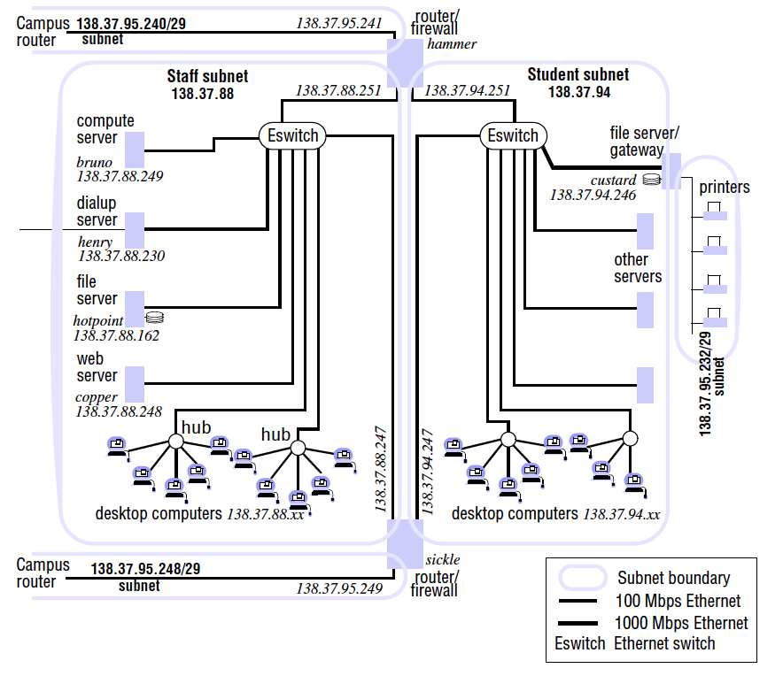
Exercise 3.15
Construct a network diagram similar to Figure 3.10 for the local network at your institution or company.
page 104.
Instructor’s Guide for Coulouris, Dollimore, Kindberg and Blair, Distributed Systems: Concepts and Design Edn. 5
© Pearson Education 2012
Notes:
See next page.
138.37.88.230
138.37.88.162
bruno
138.37.88.249
router/
sickle
138.37.95.240/29 138.37.95.241
138.37.95.249
138.37.94.247
copper
138.37.88.248
firewall
web
138.37.95.248/29
server
desktop computers 138.37.88.xx
subnet
subnet
Eswitch
138.37.88
server
server
server
138.37.88.251
custard
138.37.94.246
desktop computers 138.37.94.xx
Eswitch
138.37.94
hub hub
Staff subnet Student subnet
other
servers
router/
firewall
138.37.94.251
138.37.88.247
file server/
gateway
printers
138.37.95.232/29
subnet
Campus
router
Campus
router Subnet boundary
100 Mbps Ethernet
1000 Mbps Ethernet

Slide 25
Exercise 3.16
Describe how you would configure a firewall to protect the local network at your institution or company. What incoming and outgoing requests should it intercept?
page 125
Instructor’s Guide for Coulouris, Dollimore, Kindberg and Blair, Distributed Systems: Concepts and Design Edn. 5
© Pearson Education 2012
Notes:
Left to you.
Block everything first, then add the only required ones back.
Log every step …
---------
Left to the reader.

Slide 26
Exercise 3.17
How does a newly-installed personal computer connected to an Ethernet discover the IP addresses of local servers? How does it translate them to Ethernet addresses?
page 111
Instructor’s Guide for Coulouris, Dollimore, Kindberg and Blair, Distributed Systems: Concepts and Design Edn. 5
© Pearson Education 2012
Notes:
Neither Ethernet nor the Internet support ‘discovery’ services as such.
A newly-installed computer must be configured with the domain names of any servers that it needs to access.
DHCP.
nslookup.
ARP: Address Resolution Protocol. Each network type mush implement ARP on its own way.

Slide 27
Exercise 3.18
Can firewalls prevent denial of service attacks such as the one described on page 96? What other methods are available to deal with such attacks?
page 112, 125
Instructor’s Guide for Coulouris, Dollimore, Kindberg and Blair, Distributed Systems: Concepts and Design Edn. 5
© Pearson Education 2012
Notes:
Firewall is simply another computer program
Attacking traffic is likely to closely resemble real service requests and responses
Produce malicious messages in large quantities that firewall is likely to be overwhelmed and become bottleneck
Solve:
Big data, AI, anomaly detection

